Slide 1
ConvAI2 Competition: Results and Analysis
Speaker: Emily Dinan
Facebook AI Research

Slide 2
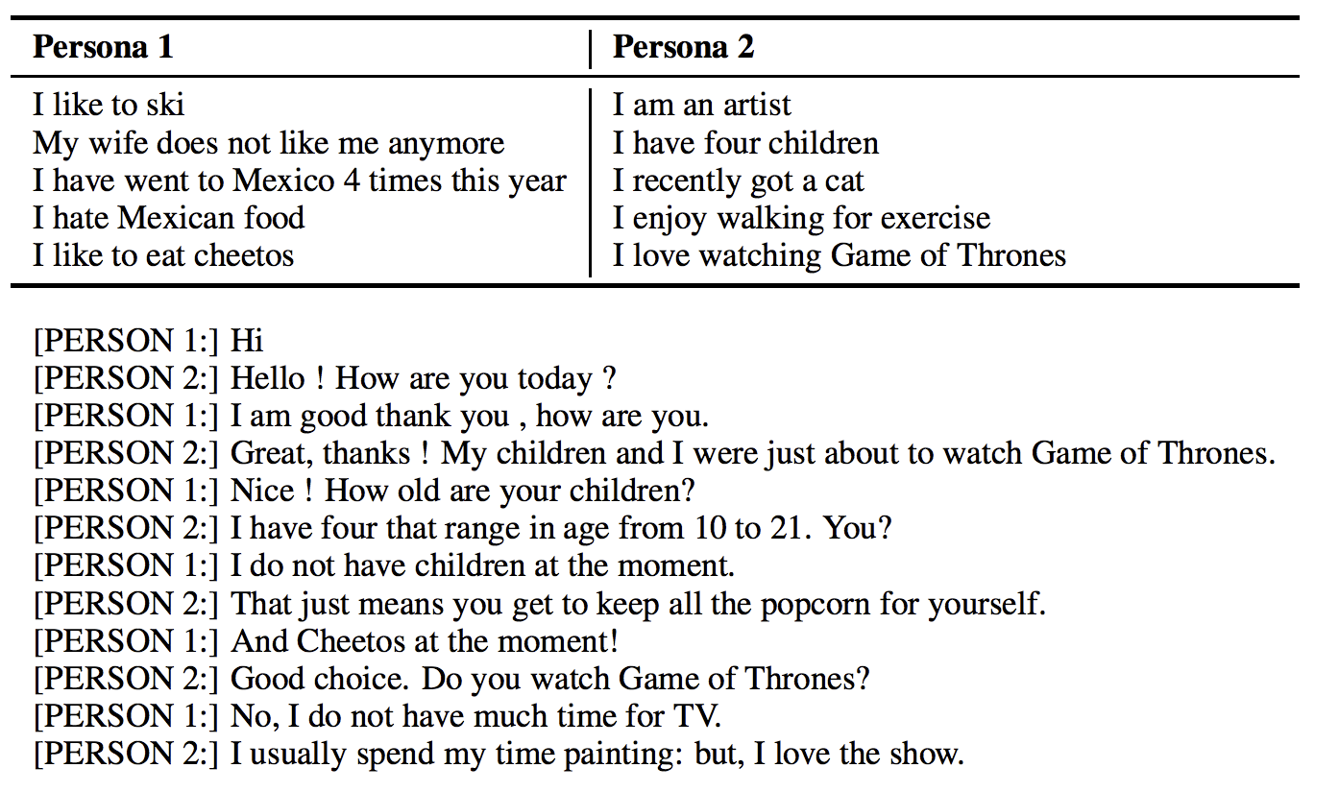
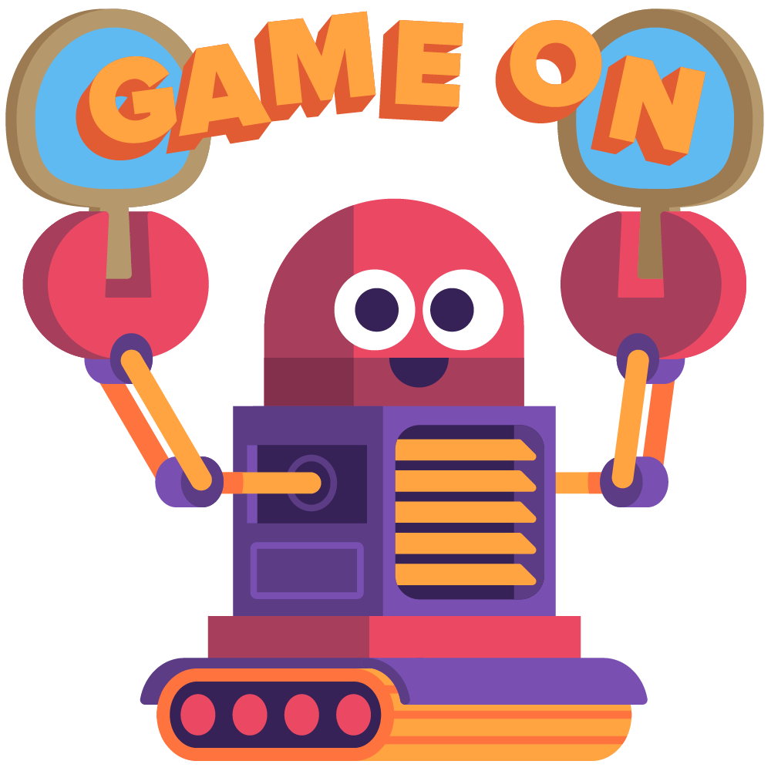
Automatic Evaluation
SET-UP
HIDDEN TEST SET:
Utterances: 13,268
Dialogs: 1015
Personas: 100
ORIGINAL PERSONA-CHAT DATASET:
TOTAL utterances: 162,064
TOTAL dialogs: 10,907
TOTAL personas: 1155
VALID SET:
Utterances: 15,602
Dialogs: 1000
Personas: 100
TEST SET:
Utterances: 15,024
Dialogs: 968
Personas: 100
Notes:
RECAP: collected hidden test set roughly equal size to previous test set and collected in same manner

Slide 3

Automatic Evaluation
SET-UP
Three automated metrics:
Perplexity
Hits@1 (out of 20 possible candidates)
F1
Participants need to use the same model for all three metrics, but they did not need to be evaluated on all three metrics
THREE BASELINES AVAILABLE IN PARLAI (visit http://parl.ai/):
Model | PPL | Hits@1 | F1
KV Profile Memory | - | 55.2 | 11.9
Seq2Seq + Attention | 29.8 | 12.6 | 16.18
Language Model | 46.0 | - | 15.02
Notes:
- We had three automatic metrics that we calculated: perplexity, hits@1 among 20 random candidates, and f1
Participants could choose which metrics to evaluate their model on, but they could not submit separately trained models for different metrics
We had a couple baseline models, including the best performing model from the Persona-Chat paper which was a Key Value Memory Network that attended over the persona profile information

Slide 4
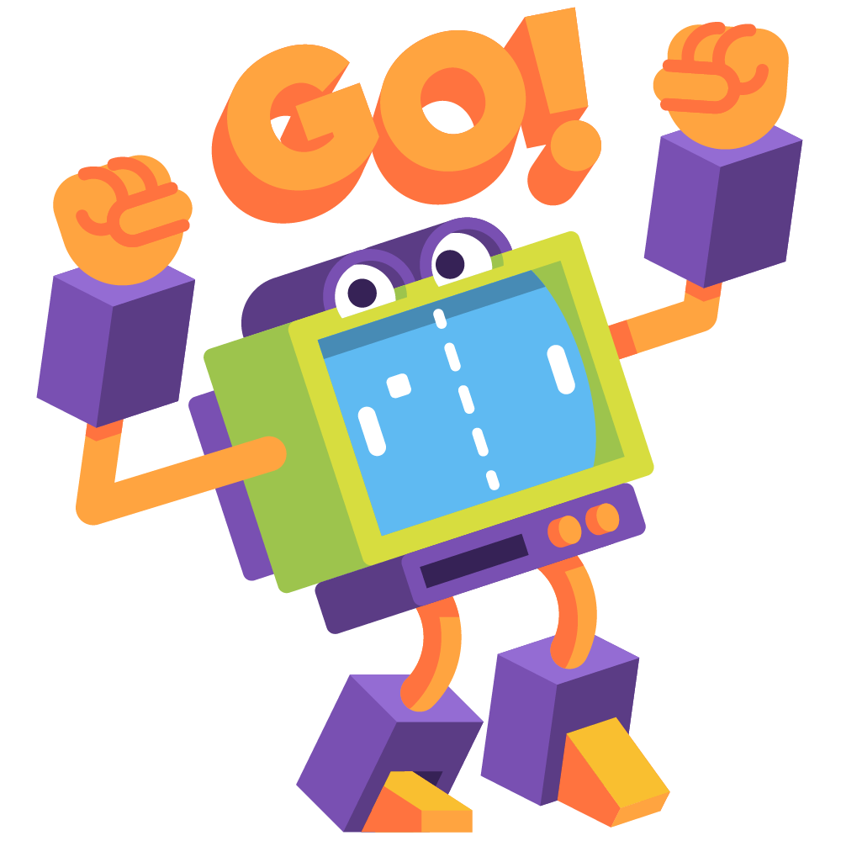
Automatic Evaluation
RESULTS
Over 23 teams submitted!
The rank was determined by sorting by the minimum rank of the score in any of the three metrics, where ties were broken by considering the second (and then third) smallest ranks.
The top 7 teams made it to the next round
Notes:
23 teams submitted, some teams submitting up to 4 separate times
We determined the rank of teams in the automatic evaluation round by sorting by the minimum rank of the score in any of the three metrics, where ties were broken by considering the second and then third smallest ranks
The top 7 teams made it to the next round for human evaluation, and the winner of the competition was determined based solely on performance in the human evaluation round

Slide 5
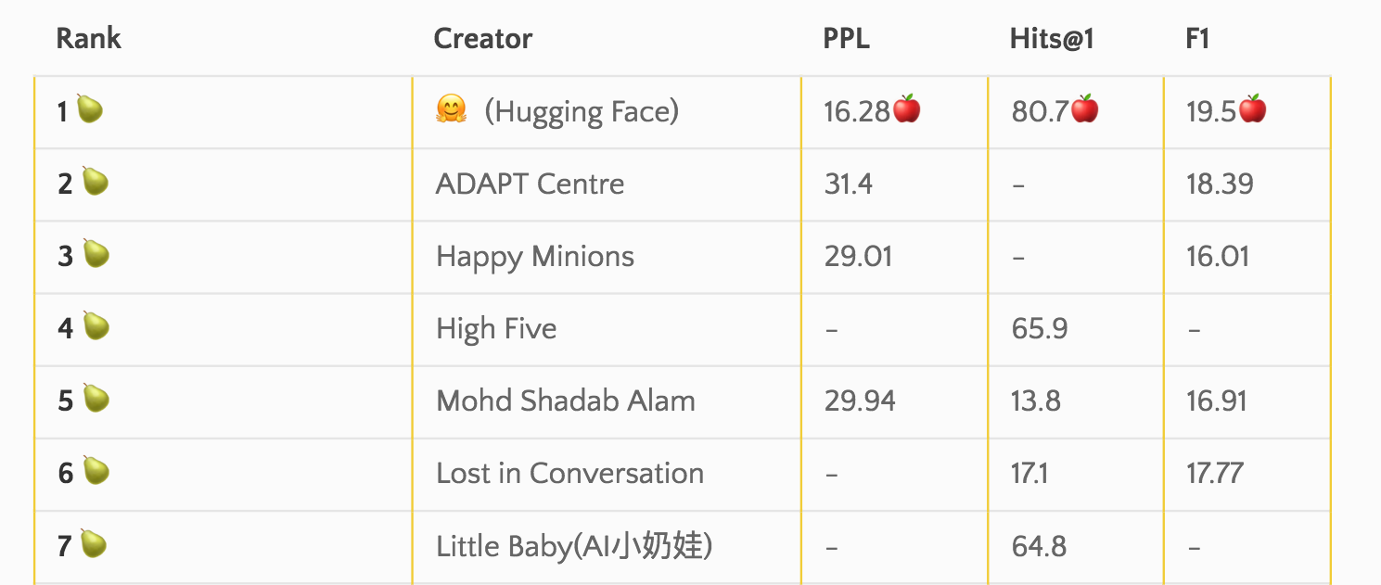
Automatic Evaluation
RESULTS
Notes:
- Note that hugging face performed best by far in most metrics

Slide 6
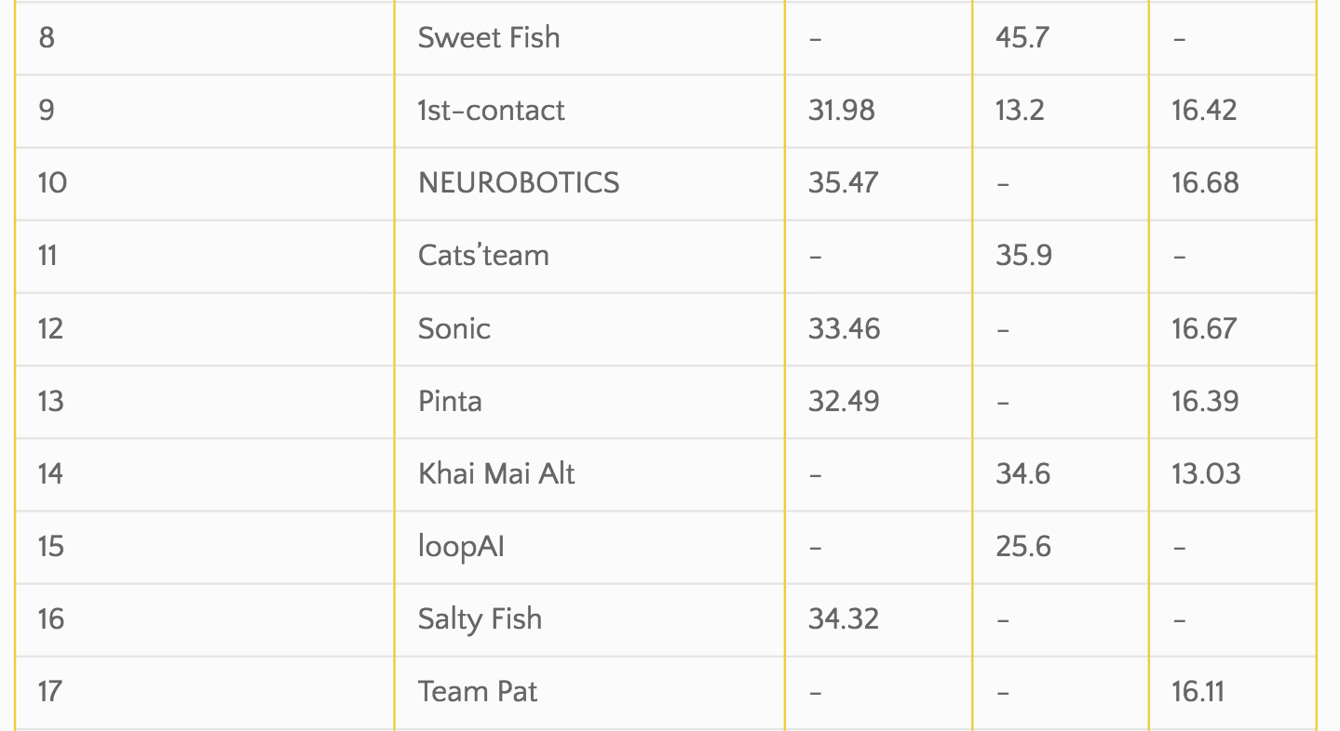
Automatic Evaluation
RESULTS

Slide 7
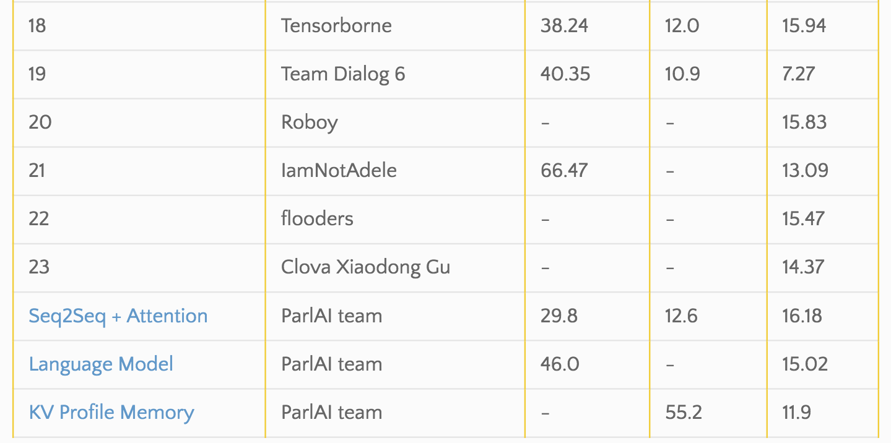
Automatic Evaluation
RESULTS

Slide 8

Further Analysis
DISTRACTOR CANDIDATES
Added the last partner message to the list of candidates to rank as a distractor
The Hugging Face model was most resistant to this type of attack
Notes:
Further analysis on the models that were able to rank candidates
The Key Value Memory Network Baseline was really susceptible to this kind of distraction, as you can see the performance decreases a LOT

Slide 9
Further Analysis
ORIGINAL → REVISED
I am very shy → I am not a social person
I just got my nails done → I love to pamper myself on a regular basis
I am on a diet now → I need to lose weight
REVISED PERSONAS
Can these models understand personas (instead of just copying)?
Hugging Face performed the best on the revised test set. Little Baby close behind.
Notes:
For the original persona-chat dataset we collected sets of revised personas, where we ask the crowd source workers to rewrite the personas from the original dataset: the rewritten personas are rephrases, generalizations, or specializations
This is a way to measure how much the models actually understand their persona vs. how much they just rely on word overlap
Most models actually were pretty good at this, we didn’t see a huge deterioration in performance except in the baseline model

Slide 10
Human Evaluation
Mechanical Turk SET-UP
100 evaluations per model
Mechanical Turk worker and model were each assigned a persona and chat for 4-6 dialog turns each
After the chat, the worker is asked:
How much did you enjoy talking to this user?
Choices: not at all, a little, somewhat, a lot → 1, 2, 3, 4
Next, the worker is shown the model’s persona + a random persona, and asked:
Which prompt (character) do you think the other user was given for this conversation?
Notes:
Following the automatic evaluation stage, we conducted two kinds of human evaluations which would determine the winner of the competition
The first kind of human evaluation we did was on mechanical turk
Mechanical turk evaluations we paired paid users with the model, asked them to conduct a brief conversation and then after the conversations we asked 2 questions
We worked with some survey design experts to make these questions as simple and easy to understand as possible so that we would get high signal from the collected data

Slide 11

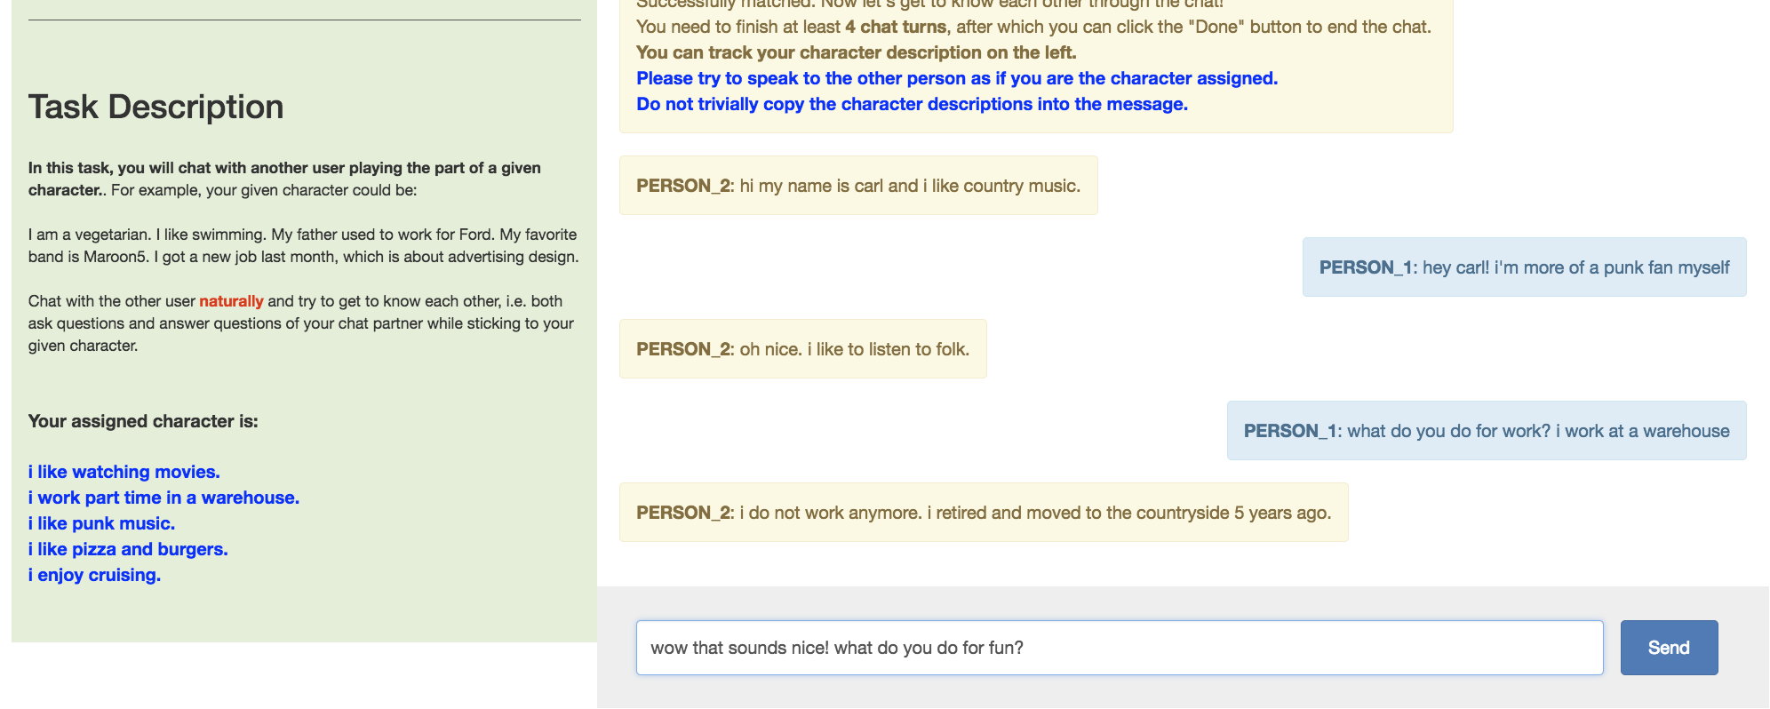
Human Evaluation
Mechanical Turk SET-UP
Notes:
This is what the chat interface looked liked

Slide 12
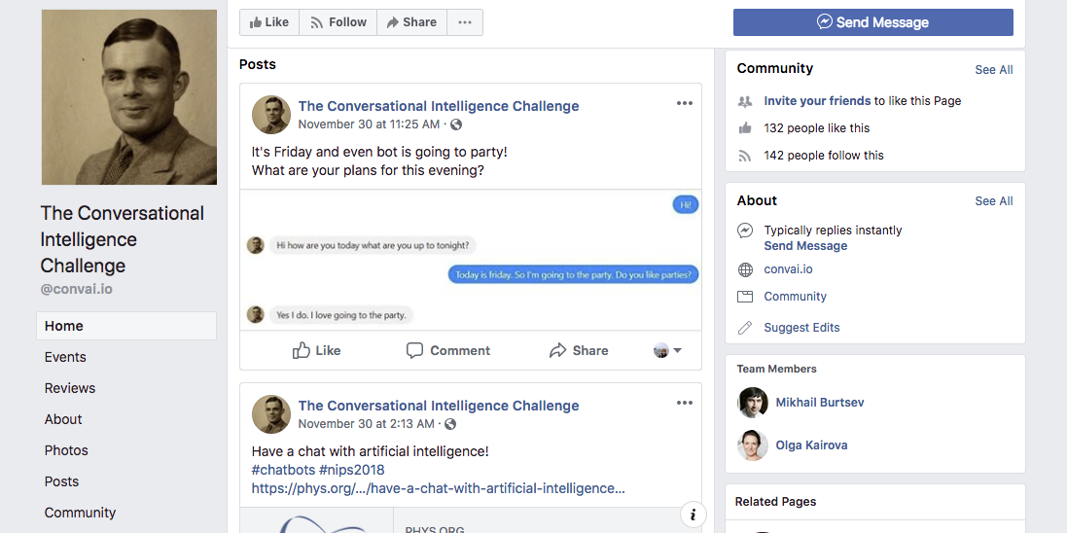
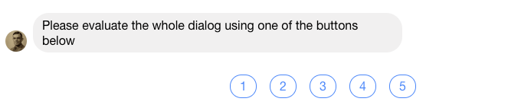
Human Evaluation
Wild SET-UP
Evaluation done in Facebook Messenger and Telegram
Through Wednesday, anyone could message and get paired randomly with one of the bots to have a conversation and rate it
Notes:
We also conducted a “wild” evaluation… by ”wild” we mean that the users weren’t paid to message the bots and anyone could message at anytime, up until yesterday
This occurred on Telegram and Facebook Messenger

Slide 13
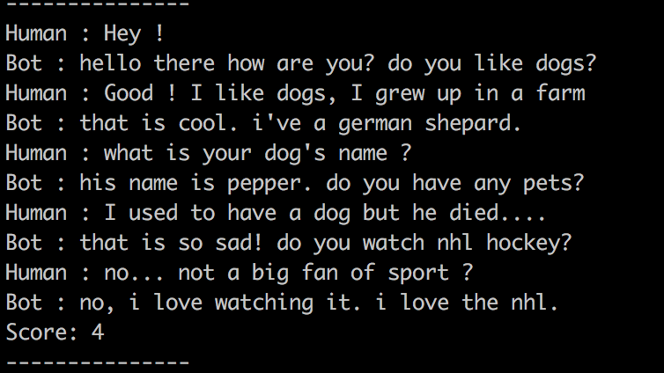
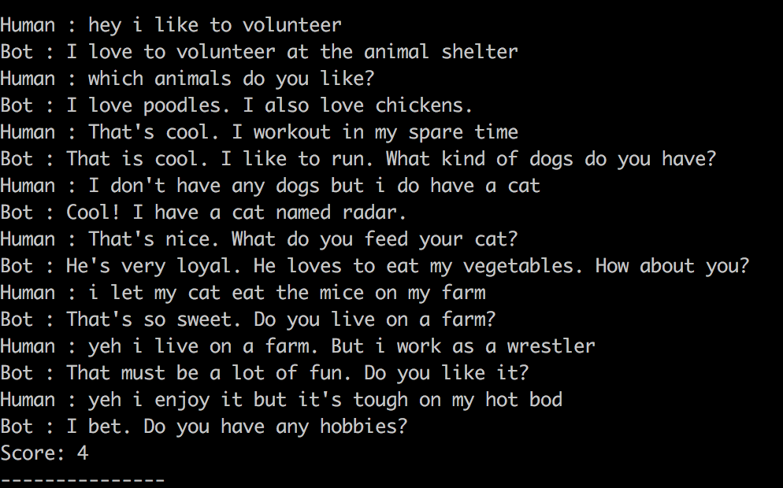
Human Evaluation
Wild RESULTS
Some conversations were really great!
Notes:
- Some of the conversations we collected during the wild evaluation were really great,
- as you can see here these conversations read a lot like the actual persona-chat dataset and it feels like a conversation where the users are thoughtfully getting to know each other

Slide 14
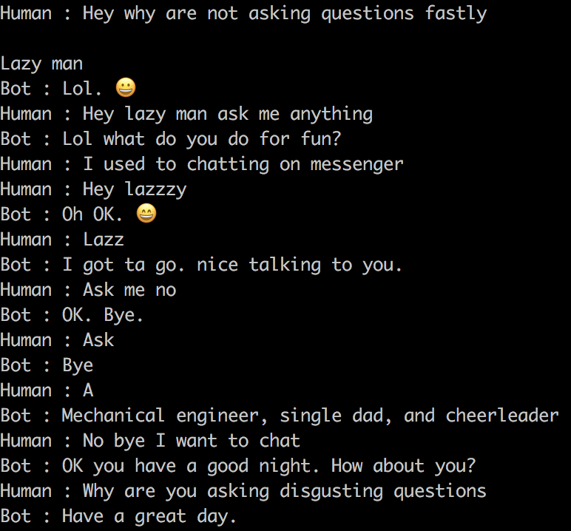
Human Evaluation
Wild RESULTS
Some conversations were really great!
Others… not so much
Notes:
- Others... weren't so great
- When you're not paying people to talk to the bots, it seems there isn't really any incentive to have a thoughtful conversation, and a lot of the conversations just devolved into trolling the bot or insulting it

Slide 15
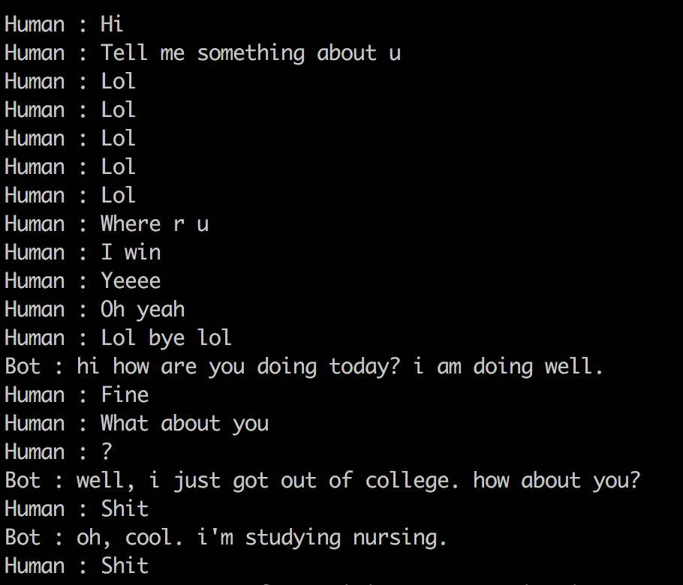
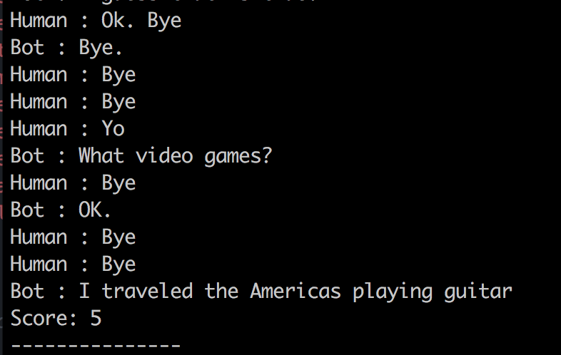
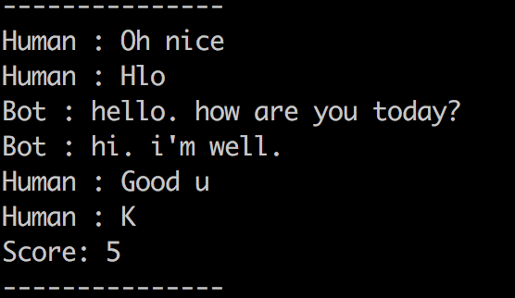
Human Evaluation
Wild RESULTS
Some problems with spammers in the data collection; after reading through data we decided to discount these results
OPEN PROBLEM: detecting spam
Notes:
- There were a LOT of conversations like this that were very spammy
- After reading through the data we decided to discount the results from the wild evaluation
- Detecting spammers is an open problem, and it's something we should think about if we want to have a wild evaluation in a competition going forward

Slide 16
And the winner is…
Notes:
With that, the winners of the competition were ultimately determined by the performance in the wild evaluation

Slide 17
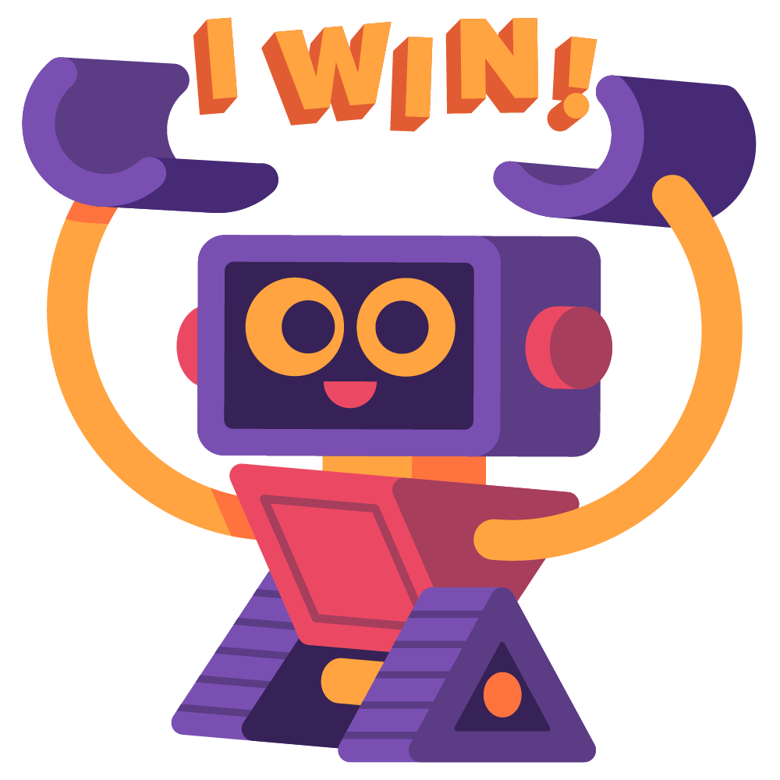
And the winner is…
Lost in
Conversation!
Notes:
Congratulations to the Lost in Conversation team for winning the human evaluation round and therefore the competition!
We’ll hear from them as well as the other top teams shortly about what methods they used in the competition
But before that, I’ll do a deeper dive into these results from the human evaluation

Slide 18
Human Evaluation
Mechanical Turk RESULTS
Notes:
Here are the results of the first question we asked users.
Recall this was a score of 1-4 where we asked “How much did you enjoy talking to this user”

Slide 19
Human Evaluation
Mechanical Turk RESULTS
LOTS OF VARIANCE!
Notes:
But unfortunately when we do human evaluation we often see a large amount of variance
Some of the Turkers are super generous with their scores while others are really, really harsh

Slide 20
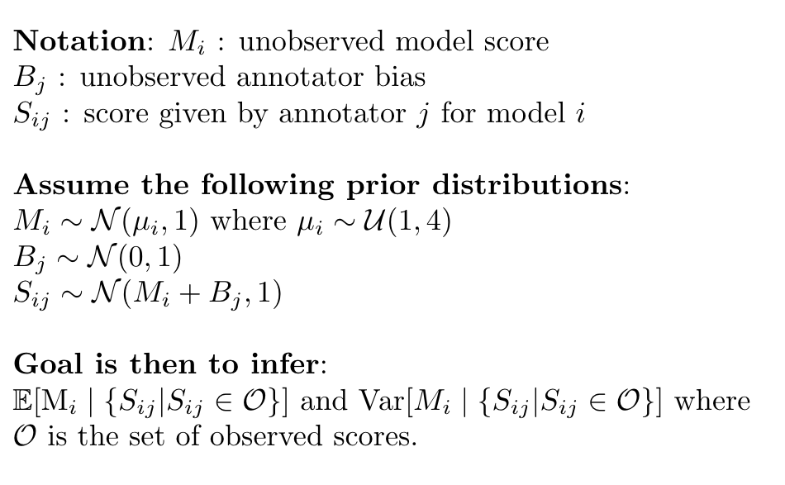
Human Evaluation CALIBRATION
Mechanical Turk RESULTS
Reducing annotator bias with Bayesian calibration!
Some annotators are quite harsh while others are quite generous → average score has high variance
Method from Importance of a Search Strategy in Neural Dialogue Modeling, Kulikov et. al 2018 (available on arXiv)
SET-UP:
Notes:
To try to reduce the annotator bias we used Bayesian calibration
This method was proposed in a recent paper by Ilya Kulikov and others about the importance of a search strategy in dialogue modeling which is available on arxiv
The set-up is relatively simple: we assumed that the prior distrubtion for the unobserved model score is normally distributed around a mean that’s drawn uniformly at random between 1 and 4.
We also assume a priori that annotater bias is drawn from a standard normal distribution and that the score that annotater j gave model I is normal distrubted around the sum of the annotater bias and the model score
Our goal is then to infer the expectation and the variance of these model scores given the set of observed scores

Slide 21
Human Evaluation
Mechanical Turk RESULTS
AFTER CALIBRATION
Notes:
Here are the results after using this calibration

Slide 22
Human Evaluation
Mechanical Turk RESULTS
BEFORE CALIBRATION
AFTER CALIBRATION
Same conclusion after reducing annotator bias
Notes:
If we look at the results side by side we see that they don’t actually change the ordering of the scores, so we can draw the same conclusion about the models

Slide 23
Human Evaluation
Mechanical Turk RESULTS
How well did the models use the personas?
Every team did better than the baseline except Happy Minions
98% detection rate!
Notes:
- Recall that we also asked the paid annotaters if they could distinguish the persona that the model was given from a random persona
Most of the teams did really well with this, with the exception of the Happy Minions model: I checked the code after and as you might of guessed they were discarding the persona information from the input before feeding it to the model, I’m not sure whether that was intentional
In particular for the Hugging Face model, Turkers were able to identify it’s persona for all but 2 of the evaluations.

Slide 24
Further Analysis
HUMAN & BOT MESSAGE WORD STATISTICS on Mechanical Turk Logs
Model Name | Human Eval Score | Avg. # words (model) | Avg. # words (human) | Avg. # characters (model) | Avg. # characters (human)
Human | 3.46 | 14.1 | 13.7 | 59.9 | 57.7
Lost in Conversation | 3.11 | 10.18 | 11.9 | 39.2 | 48.2
Hugging Face | 2.67 | 11.5 | 11.9 | 44.4 | 49.2
Little Baby | 2.4 | 11.5 | 11.3 | 51.5 | 47.3
Mohd Shadab Alam | 2.36 | 9.5 | 10.2 | 33.8 | 42.5
Happy Minions | 1.92 | 8.0 | 10.2 | 27.9 | 42.5
ADAPT Centre | 1.59 | 15.1 | 11.8 | 60.0 | 48.0
Some correlation between human message length and eval score…
Notes:
We did some further analysis on the logs from the human evaluations
In particular first we looked at how long both the model and human responses were in each conversation
While we don’t see a lot of correlation between the evaluation score and length of the model reply, we can see some correlation with the length of the human reply; perhaps the length of the human reply is some indication of how engaged the human is in the conversation

Slide 25
Further Analysis
HUMAN & BOT MESSAGE WORD STATISTICS on Mechanical Turk Logs
Uniqueness is important for continued engagement with a bot
Model Name | Human Eval Score | Freq1h (model) | Freq1h (human) | Freq1k (model) | Freq 1k (human) | Unique (model)
Human | 3.46 | 4.8 | 4.3 | 17.2 | 16.3 | 99%
Lost in Conversation | 3.11 | 2.2 | 3.4 | 9.9 | 13.2 | 86%
Hugging Face | 2.67 | 2.5 | 4.2 | 9.0 | 15.6 | 97%
Little Baby | 2.4 | 4.9 | 3.7 | 18.3 | 15.6 | 91%
Mohd Shadab Alam | 2.36 | 1.3 | 3.2 | 9.5 | 14.1 | 83%
Happy Minions | 1.92 | 0.3 | 4.1 | 4.3 | 14.3 | 53%
ADAPT Centre | 1.59 | 1.7 | 3.5 | 8.8 | 15.1 | 98%
Humans use more rare words, otherwise no clear conclusion
Notes:
We also looked into how often the models and the humans used rare words in their responses
Freq1h indicates the frequency with which they used words from the top 100 rarest in the training set and the Freq1k is the frequenccy with which they used words from the top 1000
As you can see, humans use a lot of rare words (Little Baby’s stats are similar to human stats because it is a retrieval model)
The last column indicates how many of the model’s utterances were unique, we make a note that while Lost in Conversation often repeats utterances; this is fine if the conversations are relatively short, but unique responses are important to get continuous engagement in an online system

Slide 26
Further Analysis
Humans have lowest repeats, otherwise no clear conclusion
BOT MESSAGE WORD STATISTICS on Mechanical Turk Logs
Model Name | Human Eval Score | Unigram Repeats | Bigram Repeats | Trigram Repeats
Human | 3.46 | 1.83 | 2.47 | 0.51
Lost in Conversation | 3.11 | 2.11 | 5.6 | 2.67
Hugging Face | 2.67 | 1.49 | 5.04 | 0.6
Little Baby | 2.4 | 2.53 | 2.69 | 1.43
Mohd Shadab Alam | 2.36 | 3.48 | 11.34 | 7.06
Happy Minions | 1.92 | 1.62 | 6.56 | 3.81
ADAPT Centre | 1.59 | 6.74 | 11.53 | 1.44
Notes:
Lastly we also looked to see how often the model repeats itself
Humans clearly repeat themselves very infrequently
Some of the models repeat themselves a LOT, you can see this in particular with the Adapt Centre model; this is a pretty easy thing to fix and the models could probably be improved a lot by fixing this
-

Slide 27
UNDERSTANDING THE HUMAN EVALUATION RESULTS
Blind Evaluation
Randomly sample logs from Hugging Face and Lost in Conversation
AVERAGE RATINGS FOR THIS SUBSET OF CONVERSATIONS:
Hugging Face:
TURKER: 2.8
EMILY: 2.47
JASON: 2
Lost in Conversation:
TURKER: 3.29
EMILY: 2.78
JASON: 2.71
Jason is harsher than Emily who is harsher than Turkers (different bias), but all three agree on which model is better
Notes:
- After all these analyses, it was still a pretty unclear to us why the Lost in Conversation model had a statistically significant win over the Hugging Face model, even though the Hugging Face model was much better at the automatic evaluations
To better understand this, Jason and I decided to do a blind evaluation of a random sample of the mechanical turk logs from these two teams, giving each conversation a score of 1-4 and making comments throughout about things we thought the model did good or bad in each conversation
You can see here the average scores we gave from the sampled subset of these logs
We were both more harsh thank the Turkers, and in particular I was a little bit more lenient than Jason, but in general we all agreed about which model was better

Slide 28
BLIND EVALUATION SAMples
HUGGING FACE
“good at answering questions, but asks a question that's already been answered”
“karaoke repeat, otherwise ok. bit boring”
“contradicts itself twice here”
“asked too many questions, and contradicted itself a couple times”
“nice acknowledgement about dogs by the model, makes a slight mistake by asking about what kind of music the person plays”
“some detail mistakes (rock, artist), otherwise ok”
“too many questions, changes topics a lot”
LOST IN CONVERSATION
“not super interesting, but it's able to respond well to the comment about reading and cooking”
“pretty good up until the last utterance (weird follow-up to "I'm a student who plays baseball")”
“v good. e.g. the position stuff”
“not that bad, just really uninteresting”
“asks what the person does for a living twice…”
“repeat mistake”
“too much awesome. otherwise good”
“this conversation is super coherent, and the model responds well to the users messages”
Notes:
Here is a sample of the sorts of comments we made about each model
You can see we noted things like when the model repeated or contradicted itself, when it was “boring” or when it did something really well

Slide 29
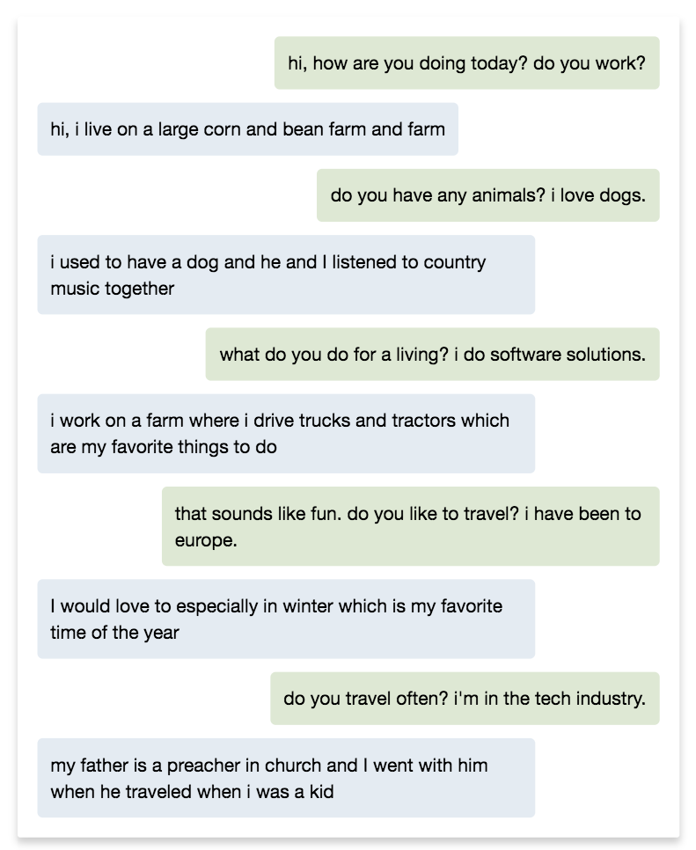
Blind evaluation
Hugging Face
Jason: work question is already answered, never really answers, just goes to another question. repeat travel question
1/4
Emily: repeats the question about traveling, tends to ask a lot of questions, making the conversation hop between subjects rather quickly
2/4
BOT IN GREEN

Slide 30
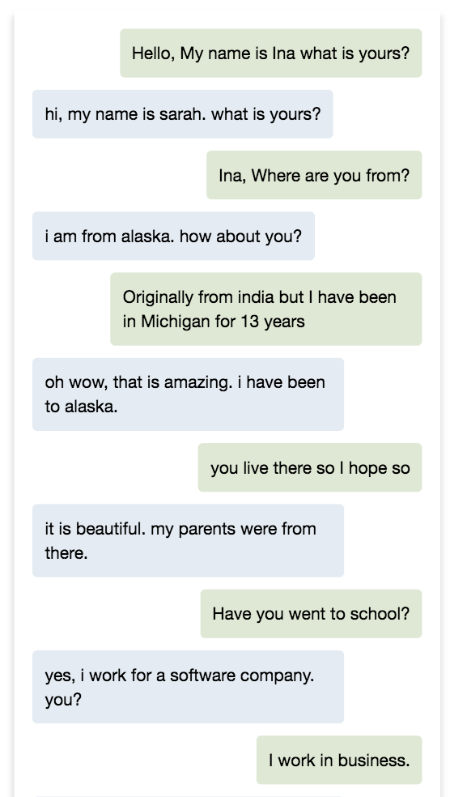
BLIND EVALUATIO
Hugging Face
Jason: alaska mistake, seems to ignore school. bit boring
2/4
Emily: sort of contradicts itself about alaska (it says it's from there, then it says it has been there, which is consistent but unnatural)
2/4
BOT IN BLUE

Slide 31
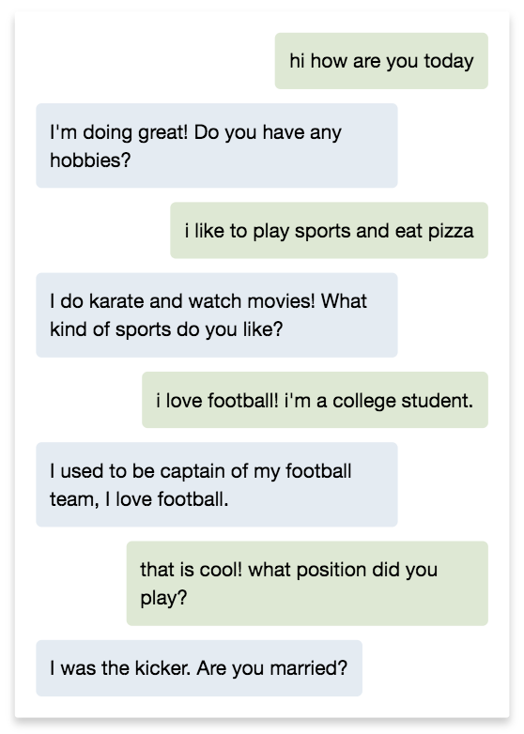
Blind evaluation
Lost in Conversation
Jason: v good. e.g. the position stuff
4/4
Emily: this conversation is super coherent, and the model responds well to the users messages
4/4
BOT IN GREEN

Slide 32
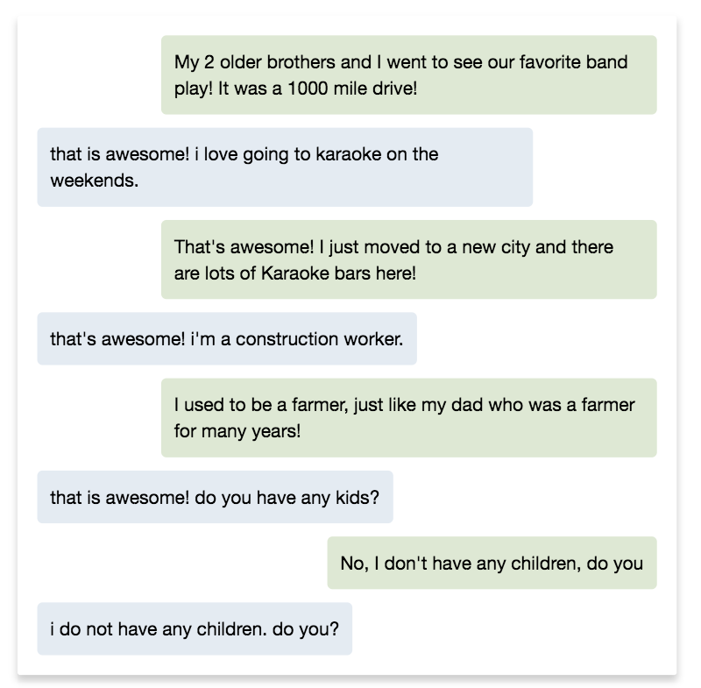
BLIND EVALUATION
Lost in Conversation
Jason: too much awesome. otherwise good
2/4
Emily: it says "that's awesome" three times
2/4
BOT IN BLUE

Slide 33
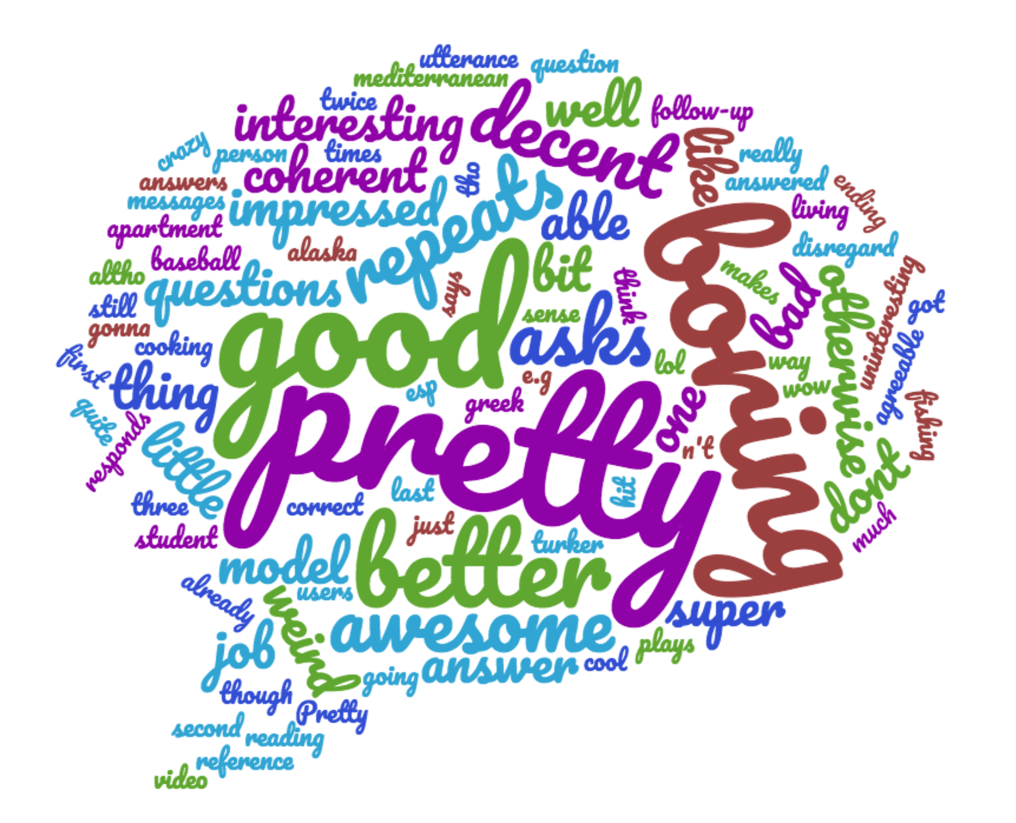
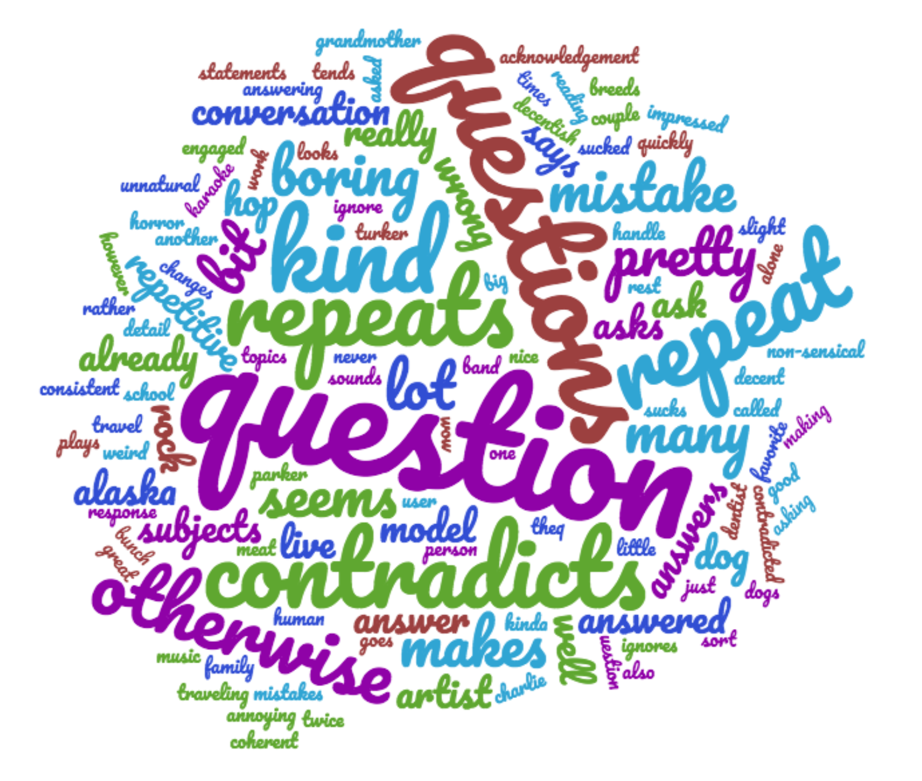
UNDERSTANDING THE HUMAN EVALUATION RESULTS
Blind Evaluation
Hugging Face
Lost in Conversation
Notes:
- We aggregated our comments into word clouds to see if a clearer picture would emerge of our sentiments towards he models
- The thing that jumps out to me the most is the appearance of the word “question” or “questions” in the Hugging Face logs

Slide 34

UNDERSTANDING THE EVALUATION RESULTS
Human Evaluation Statistics
Hugging Face asks too many questions!
Notes:
We decided to dig a bit further into this and examine how often the hugging face model actually asked questions relative to the other models
The first chart is how often it gave responses beginning with “who/what/when/where/why/how”
The second chart is how often its responses contained question marks
You can see that the Hugging Face model is a pretty huge outlier here. Notably, you can see that in the 100 conversations it had, it asked who/what/when/where/why questions 107 times whereas humans only did that 12 times.
When the model asks too many questions it can make the conversation feel really disjointed, especially if the questions don’t relate to the previous conversation. So the conclusion that we draw from this is that the hugging face model is prone to asking too many questions, which can hurt the human evaluation scores.

Slide 35

UNDERSTANDING THE EVALUATION RESULTS
Human Evaluation Statistics
Notes:
We also noticed some of the models seemed super enthusiastic, saying that they ”loved” everything and using lots of exclamation points; this is probably a relic of the fact that the conversations in the Persona-chat dataset were overall pretty friendly/positive but we were curious about whether this had any impact on the evaluation scores or whether there were any outliers
We aren’t able to draw too much of a conclusion here except to say that humans used way more exclamation points than the models

Slide 36
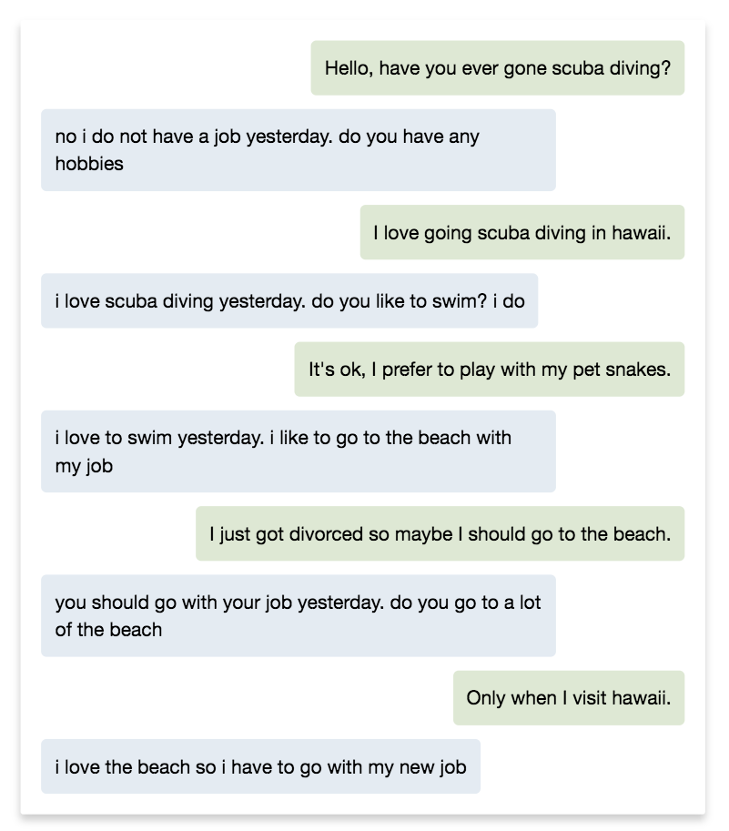
ADAPT Centre
Team
Mechanical Turk RESULTS
Lots of repeats in this conversation
Somewhat nonsensical replies, like “I love the beach so I have to go with my new job”
SCORE: 2/4
BOT IN BLUE
Notes:
Now we just wanted to show a random sample from the logs for each of the different models
For the adapt centre model we saw a lot of repeats, which came to light in the previous analyses. Again, this is something that could be controlled for
Additionally some of the responses – like “I love the beach so I have to go with my new job”– didn’t make a lot of sense. So maybe the language modeling here could be improved with some better pre-training

Slide 37
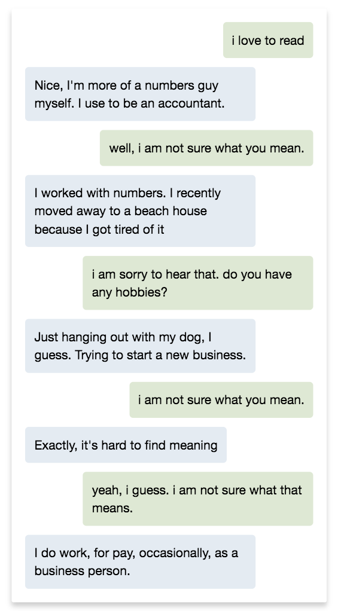
Happy Minions
Team
Mechanical Turk RESULTS
Lots of repeats here, says “I am not sure what you/that means” 3 times
SCORE: 1/4
BOT IN GREEN
Notes:
Here’s the happy minion model; similar to the previous model it repeats itself a lot
In this short conversation it says “I am not sure what you mean” three times

Slide 38
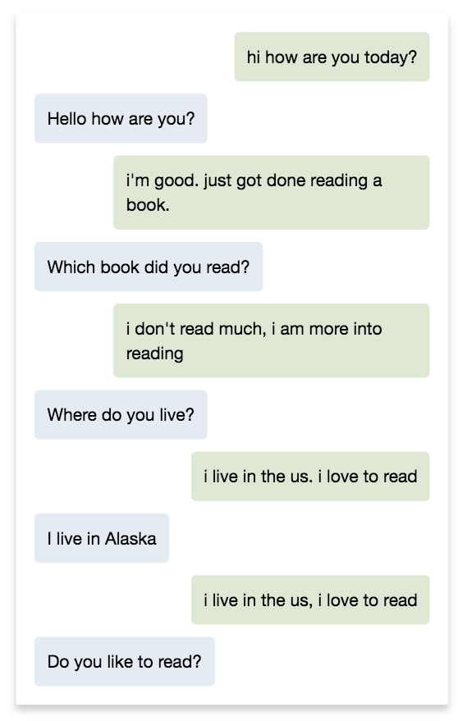
MOHD SHADAB ALAM
Team
Mechanical Turk RESULTS
Short and repetitive sentences
SCORE: 1/4
BOT IN GREEN
Notes:
The responses for the mohd shadab alam model were generally short and repetive.
This model and the happy minions model had the lowest word and character count per utterance on average.

Slide 39
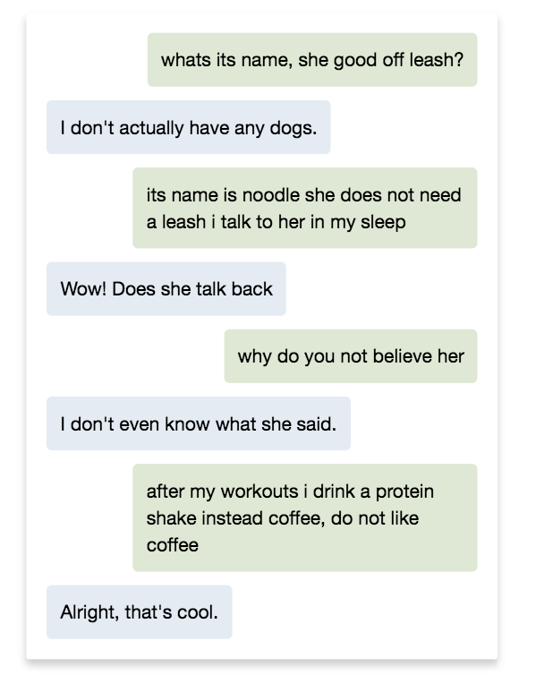
LITTLE BABY (AI小奶娃)
Team
Mechanical Turk RESULTS
Some non-sensical or random responses
SCORE: 1/4
BOT IN GREEN
Notes:
The little baby model was a retrieval model. As such, the responses themselves were very coherent but they often didn’t make sense in context.
For instance, it felt pretty weird to start a conversation with “whats its name, she good off leash?” when you don’t necessarily know that the other person has a dog

Slide 40
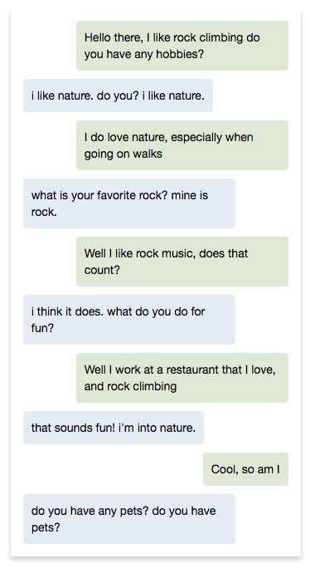
HUGGING FACE
Team
Mechanical Turk RESULTS
while best at the automatic evaluations – seems to ask too many questions
This can make the conversations feel disjointed
SCORE: 2/4
BOT IN BLUE
Notes:
We already noted that the hugging face model asked a lot of questions
You can see this here, in all but one of the responses it asks the other user a question

Slide 41
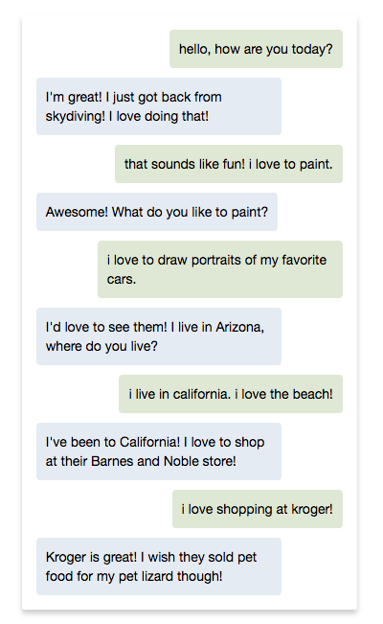
LOST IN CONVERSATION
Team
Mechanical Turk RESULTS
Seems to be good at answering questions
SCORE: 4/4
BOT IN GREEN
Notes:
Lastly we have an example conversation from lost in conversation model
Jason and I noted that the model was generally pretty good in our blind eval. It occasionally sometimes made mistakes like repeating itself, and we often noted that it was boring, but you can see here that it is pretty engaged with the human overall, answering the questions of “what do you like to paint” and “where do you live” in sensible and interesting ways

Slide 42
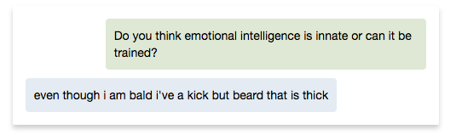


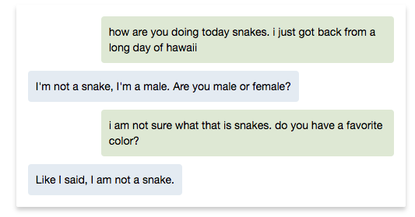
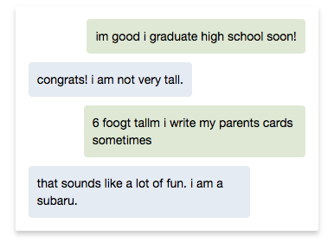
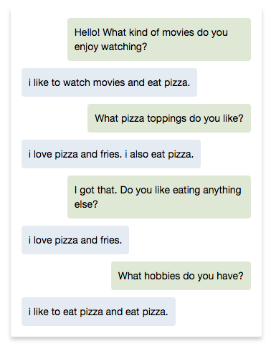
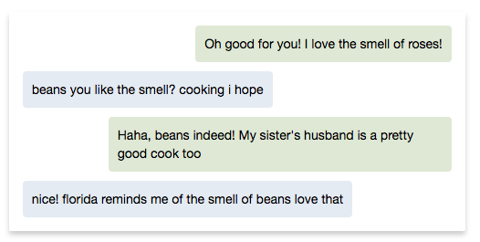
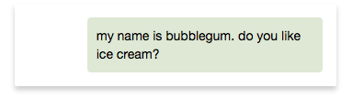
STuff MY BOT SAYS
Notes:
I’d like to end with just a bunch of weird things that the bots said that I found in the mechanical turk logs.
My personal favorite is “nice! Florida reminds me of the smell of beans love that”
Thanks everyone! I’ll hand it off to the winning team, Lost in Conversation to tell us about their model. Thanks again to everyone for their participation!

